Slide 1
Module 3
Activity Planning and Risk Management

Slide 2
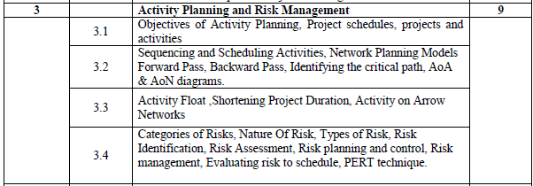
Module 3

Slide 3
Objectives of Activity Planning
Activity planning aims to achieve a number of objectives as follows:
Feasibility Assessment
Resource Allocation
Detailed Costing
Motivation
Coordination
F
R
D
M
C

Slide 4
Objectives of Activity Planning
Feasibility Assessment-
A project that may have been estimated as requiring two work-years’ effort might not mean that it would be feasible
to complete within say three months with eight people to work on it.
It will depend upon
the availability of staff and
the degree to which activities may be undertaken in parallel.
Resource Allocation-
What are the most effective ways of allocating resources to the project.
F
R
D
M
C

Slide 5
Objectives of Activity Planning
Detailed Costing-
When is that expenditure likely to take place?
With activity plan and allocating specific resources, detailed estimates of cost and timings can be obtained.
Motivation-
Providing targets and being seen to monitor achievement against target is an effective way of motivating staff.
Coordination-
When do the staff in different departments need to be available to work on a particular project
When do staff need to be transferred between projects?
F
R
D
M
C

Slide 6
Project Schedule
Creating a project schedule comprises four main stages:
Ideal Activity plan
Activity Risk Analysis
Resource Allocation
Schedule Production

Slide 7
‘Step Wise’ - an overview
Activity plan-generated by Step4 and Step 5
Activity Risk Analysis-Step 6 of Step Wise planning
0.Select
project
1. Identify
project objectives
2. Identify project
infrastructure
3. Analyse
project
characteristics
Review
4. Identify products
and activities
Lower
level
detail
5. Estimate effort
for activity
For each
activity
6. Identify activity
risks
10. Lower level
planning
7. Allocate
resources
9. Execute plan
8. Review/ publicize
plan
Notes:
This is an overview of the main steps, details of which will be discussed in the following overheads:
0. Select project There must be some process by which the project to be executed was selected. Chapter 3 on project evaluation looks at this in more detail.
1. Identify project objectives It is important that at the outset the main stakeholders are all aware of the precise objectives of the project. This has already been discussed in Chapter 1.
2. Identify project infrastructure This may not be a significant step where you are working on an in-house project in a very familiar environment. However, where the project is being carried out for external clients then you may need to investigate the characteristics of the environment in which the project is to be carried out.
3. Analyse project characteristics Different types of project will need different technical and management approaches. For example, a project to implement control software embedded in industrial equipment will need a different set of methods than a project to implement a business information system. A multimedia application would again need a different set of activities. (This is not to say that there could not be considerable overlaps in the approaches).
4. Identify products and activities With software projects, it is best to start by listing the products, both deliverable and intermediate, to be created. The activities needed to create the products can then be identified
5. Estimate effort for activity.
6. Identify activity risks Having assessed the amount of effort and the elapsed time for a project, the reasons why these might be vary during the actual execution of the project need to be considered. Where there is a very high risk of additional effort/time being needed then actions to reduce this risk may be formulated.
7. Allocate resources With software projects, these resources will mainly be staff, but could be equipment etc.
8. Review/publicize It is no good having a plan if no one knows about it
9. Execute Plan
10. Lower level planning Not all of a project, especially when it is large, can be planned in detail at the outset. Not all the information needed to plan the later stages will be available at the beginning: for example software development cannot be broken down into precise sub-tasks with realistic target times until more is known about what the overall design of the system is known.

Slide 8
Project Schedule
Ideal Activity plan
A plan of when each activity would ideally be undertaken when resources are not a constraint.
Creation of Ideal Activity plan
Activity Risk Analysis
Identifying potential problems with the activity plan.
Suggested alterations to the activity plan and resulting implications for resource allocation

Slide 9
Project Schedule
Resource Allocation
Expected availability of resources might place constraints on when certain activities can be carried out.
Ideal plan need to be adapted to take account of this
Schedule Production
Once resources have been allocated to each activity
Draw up and publish a project schedule which indicates
planned start and completion dates
a resource requirement statement for each activity

Slide 10
Project & Activities: Defining activities
Activity networks/Activity are based on some assumptions:
A project is:
Composed of a number of activities
May start when at least one of its activities is ready to start
Completed when all its activities are completed

Slide 11
Defining activities – Assumptions
An activity
Must have clearly defined start and end-points,
normally marked by the production of a tangible deliverable.
If an activity requires a resource then
that resource requirements must be forecastable and
are assumed to be required at a constant level throughout the duration of the activity
Notes:
Where some of these assumptions do not apply (e.g. clearly defined start and end-points, certainty of durations) there are more complicated techniques that can be applied, e.g. PERT risk – see Section 7.10.

Slide 12
Defining activities -continued
An activity
Must have a duration that can be forecasted assuming normal circumstances and availability of resources.
May be dependent on other activities being completed first (precedence networks)
Notes:
Where some of these assumptions do not apply (e.g. clearly defined start and end-points, certainty of durations) there are more complicated techniques that can be applied, e.g. PERT risk – see Section 7.10.

Slide 13
Defining activities -continued
Activities must be defined so that they meet these criteria.
Any activity that does not meet these criteria must be redefined.
Notes:
Where some of these assumptions do not apply (e.g. clearly defined start and end-points, certainty of durations) there are more complicated techniques that can be applied, e.g. PERT risk – see Section 7.10.

Slide 14
Identifying activities
Three approaches to identify activities or tasks:
Activity based approach
Product-based approach
Hybrid approach
Notes:
Section 6.5 of the textbook provides more details are examples. Lecture 3 (An overview of project planning) had introduced Product Breakdown Structures already.

Slide 15
Activity based approach
One approach-
Creating a list of all activities involved in the project.
It might need brainstorming session of project team or
Analysis of similar past projects
Risks involved: omitting or double counting of tasks
Notes:
Section 6.5 of the textbook provides more details are examples. Lecture 3 (An overview of project planning) had introduced Product Breakdown Structures already.

Slide 16
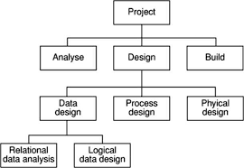
Activity based approach
Advantages:
Likely to result in a task catalogues
that is complete and composed of non-overlapping activities.
Notes:
Section 6.5 of the textbook provides more details are examples. Lecture 3 (An overview of project planning) had introduced Product Breakdown Structures already.

Slide 17
Activity based approach
Second approach-
Work-based: draw-up a Work Breakdown Structure listing the work items needed
Creation of WBS
Identifying the main task required to complete the project and
then breaking each of these down into a set of lower level tasks.
Notes:
Section 6.5 of the textbook provides more details are examples. Lecture 3 (An overview of project planning) had introduced Product Breakdown Structures already.

Slide 18
Product-based approach
Product-based approach
list the deliverable and intermediate products of project – product breakdown structure (PBS)
Identify the order in which products have to be created-PFD
work out the activities needed to create the products
Notes:
Section 6.5 of the textbook provides more details are examples. Lecture 3 (An overview of project planning) had introduced Product Breakdown Structures already.

Slide 19
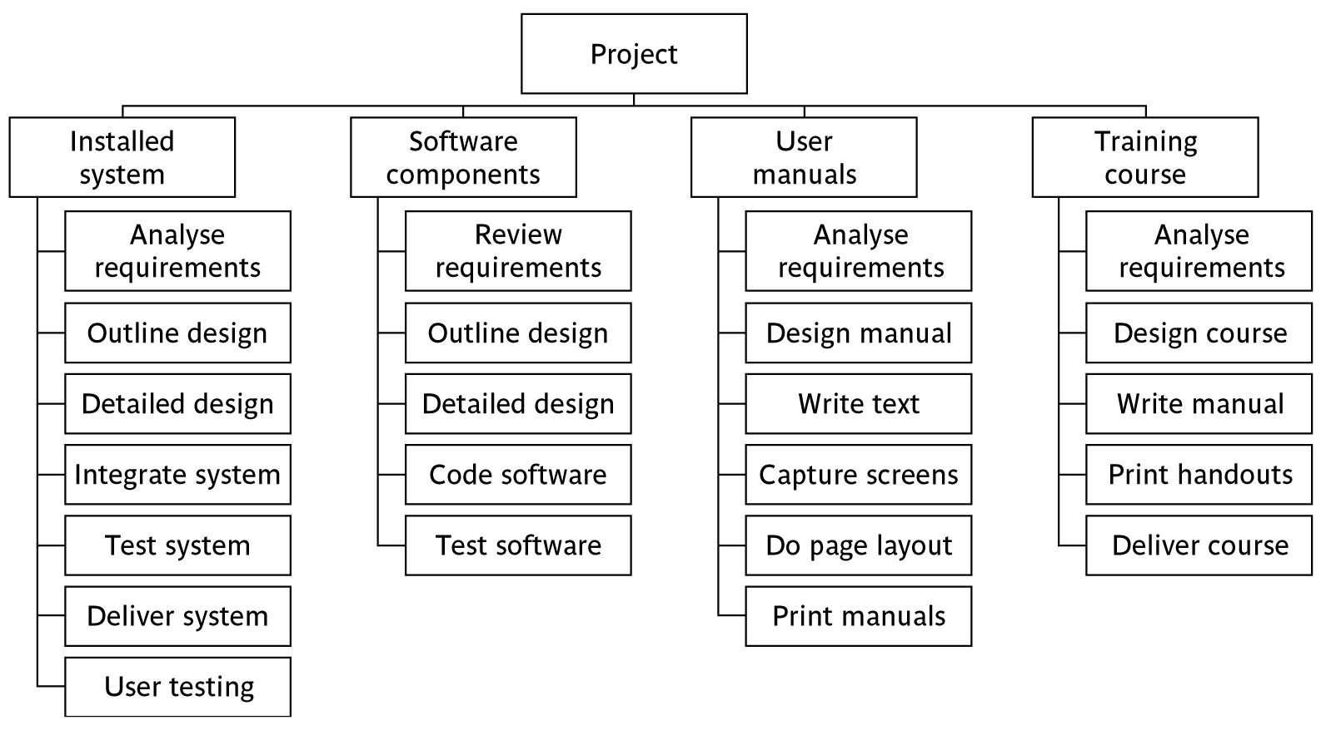
Hybrid approach
Notes:
The IBM MITP approach suggested the following 5 levels
Level 1: Project
Level 2: Deliverables
Level 3: Components – which are key work items needed to produce the deliverables
Level 4: Work packages: groups of tasks needed to produce the components
Level 5: Tasks

Slide 20
Hybrid approach
Hybrid approach-
Structuring both products and activity
The degree to which the structuring is product based or activity based might be influenced by
the nature of the project and
the development method adopted.
Notes:
Section 6.5 of the textbook provides more details are examples. Lecture 3 (An overview of project planning) had introduced Product Breakdown Structures already.

Slide 21
Sequencing and Scheduling Activities
Let us consider in outline a schedule for a small project.
One way is to use a bar chart.

Slide 22
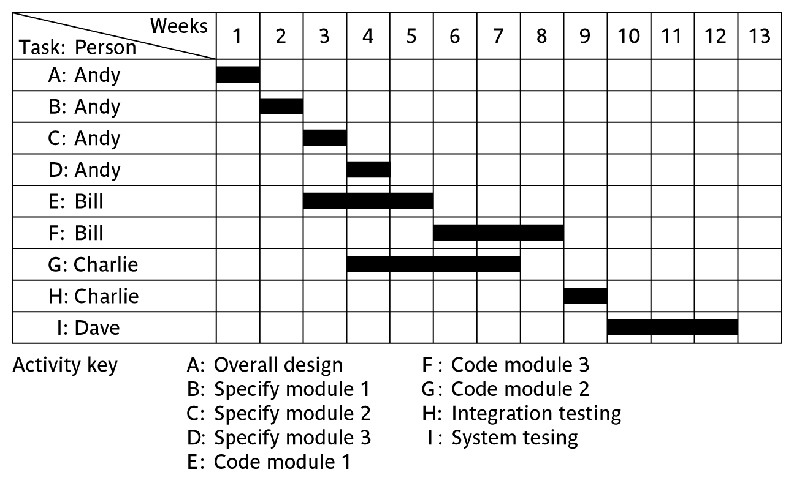
Sequencing and Scheduling Activities
A project plan as a bar chart
Notes:
The chart tells us who is doing what and when.

Slide 23
Sequencing and Scheduling Activities
The Chart has taken into account the nature of the development process.
Certain tasks must be completed before others may start and the resources that are available
Notes:
The chart tells us who is doing what and when.

Slide 24
Sequencing and Scheduling Activities
For eg- Activity C follows Activity B because Andy cannot work on both tasks at the same time.
Thus, we have sequenced the tasks (identified the dependencies) and scheduled them.
Notes:
The chart tells us who is doing what and when.

Slide 25
Sequencing and Scheduling Activities
In the case of small projects,
this combined sequencing-scheduling approach might be quite suitable,
particularly where we wish to allocate individuals to particular tasks at an early planning stage.
However, on larger projects
it is better to separate out these two activities:
to sequence the task according to their logical relationships and
then to schedule them taking into account resources and other factors.

Slide 26
Network Planning Models
These project scheduling techniques model the project's activities and their relationships as a network.
In the network, time flows from left to right.
The two best known techniques being CPM (Critical Path Method) and PERT (Program Evaluation Review Techniques).

Slide 27
AOA Networks
Both of these approaches used an activity-on-arrow approach to visualize the project as a network where
activities are drawn as arrows joining circles, or nodes which possibly represent the start and end of the activity

Slide 28
AON Networks
A recent variant of these techniques- Precedence Networks have become popular.
They use Activity-on-Node Networks where activities are represented as nodes and the links between nodes represent precedence requirements.
Avoids some of the problems inherent in AOA Networks.
More popular

Slide 29
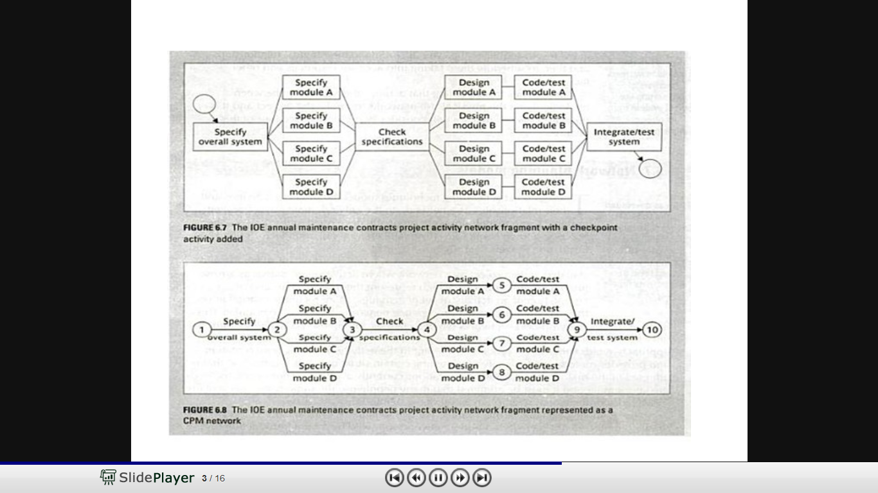
Fragment of a network as an AON Network
Fragment of a network as an AOA Network using CPM technique

Slide 30
Constructing Precedence Networks
Representing activities and their relationship as a graph.
Nodes=activities
Links=Precedence requirements

Slide 31
Constructing Precedence Networks
A Project network should have only one start node.
It is possible to draw a network with more than one starting node,
it is undesirable to do so as it is a potential source of confusion.
In cases, where more than one activity can start immediately the project starts.
Invent a start activity which has zero duration but may have an actual start date.

Slide 32
Constructing Precedence Networks
A Project Network should have only one end node.
End node designates the completion of the project and a project may finish only once.
It is possible to draw a network with more than one end node, it will almost certainly lead to confusion.
When the completion of an activity depends upon more than one final activity, it is normal to invent a ‘finish’ ativity.

Slide 33
Constructing Precedence Networks
A Node has duration
A node represents an activity and activities take time to execute
Links normally have no duration
Links represent relationship between activities

Slide 34
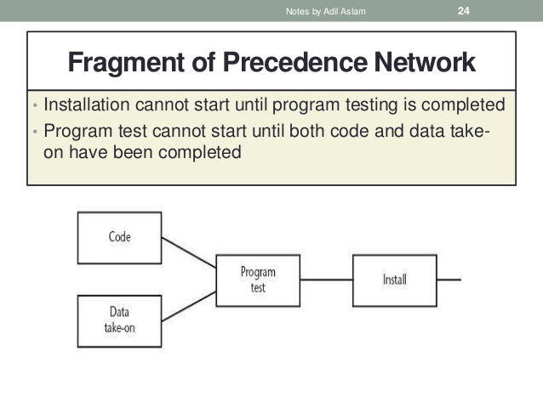
Constructing Precedence Networks
Precedents are the immediate preceding activities.
Program test cannot start until both ‘Code’ and ‘Data take-on’ have been completed
Install cannot start until ‘Program test’ has finished.

Slide 35
Constructing Precedence Networks
‘Code’ and ‘Data take-on’ are precedents of Program test .
‘Program test’ is precedent of Install.

Slide 36
Constructing Precedence Networks
Time moves from left to right
A network may not contain loops
A loop is an error, it represents a situation that cannot occur in practice.
While loop in the sense of iteration, may occur in practice, they cannot be directly represented in a project network.

Slide 37
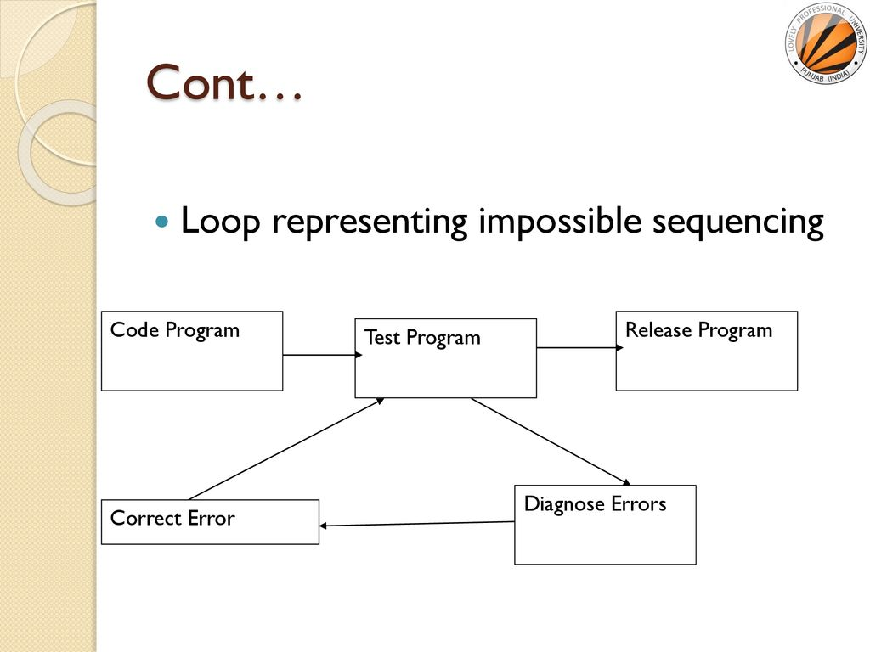
Constructing Precedence Networks
A network may not contain loops
A loop presents an impossible situation
Program testing cannot start until the errors have been corrected.

Slide 38
Constructing Precedence Networks
Although it is easy to see the loop in this simple network fragment,
very large networks can easily contain complex loops which are difficult to spot when they are initially constructed.
Eventually, all network planning applications will detect loops and
generate error messages when they are found.

Slide 39
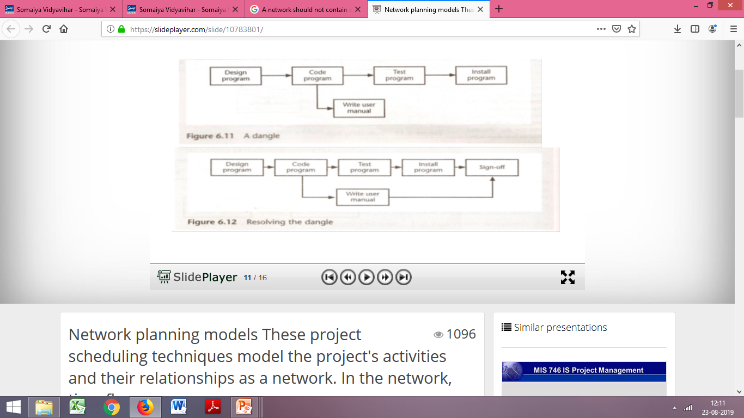
Constructing Precedence Networks
A Network should not contain dangles
A dangling activity such as ‘Write user manual’ should not exist as it is likely to lead to errors in subsequent analysis.
In many cases, dangling activities indicate errors in logic when activities are added as an afterthought.

Slide 40
Constructing Precedence Networks
We should redraw the network with a final completion activity, which is a more accurate representation of what should happen

Slide 41
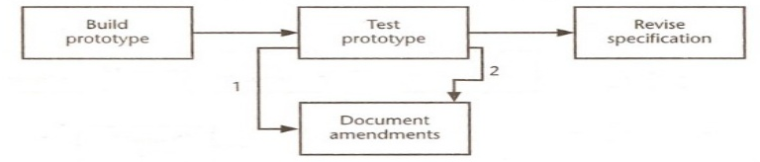
Lagged Activities
When activities can occur in parallel with a time lag between , we represent the lag with a duration on the linking arrow.
Documenting amendments can
start one day after the start of prototype testing and
will be completed two days after prototype testing is completed.

Slide 42
Lagged activities
where there is a fixed delay between activities e.g. seven days notice has to be given to users that a new release has been signed off and is to be installed
Acceptance
testing
7days
Install new
release
20 days
1day
Notes:
See Section 6.8 ‘Formulating a network model’ page 143 for lagged activities.

Slide 43
Hammock Activities
Have zero duration
Assumed to
start at the same time as the first “Hammocked activity”
End at the same time as the last one
Representing Overhead costs or other resources that will be incurred or used at a constant rate

Slide 44
Labelling Conventions for AON Networks
Number of different conventions exist
The following one is based on British Standard BS 4335
Earliest Start | Duration | Earliest Finish
Activity Label, Activity Description
Latest Start | Float | Latest finish

Slide 45
Labelling Conventions for AON Networks
Activity Label-code to uniquely identify the activity
Activity Description-Brief Activity name
Earliest Start | Duration | Earliest Finish
Activity Label, Activity Description
Latest Start | Float | Latest finish

Slide 46
Adding time dimension
Each activity should have an estimate of its duration
The network is analyzed by carrying out a
Forward pass- to calculate the earliest dates at which activities may commence and the project be completed
Backward pass-to calculate the latest start dates for activities and the critical path

Slide 47
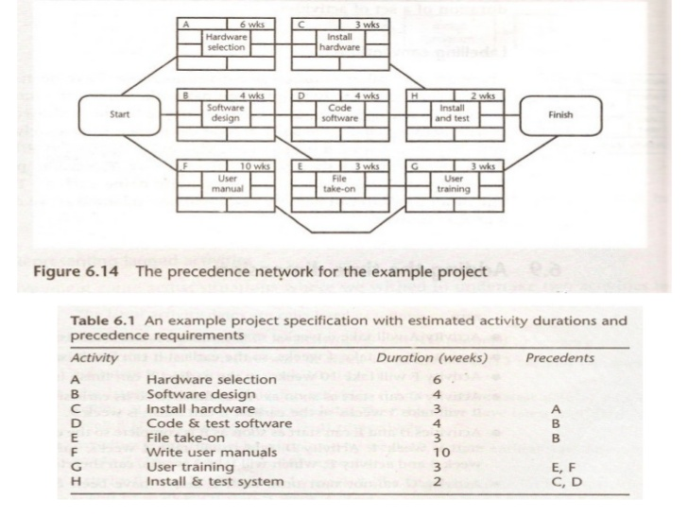
Adding time dimension
Draw the precedence network for the following project specification using the BS labelling convention.

Slide 48
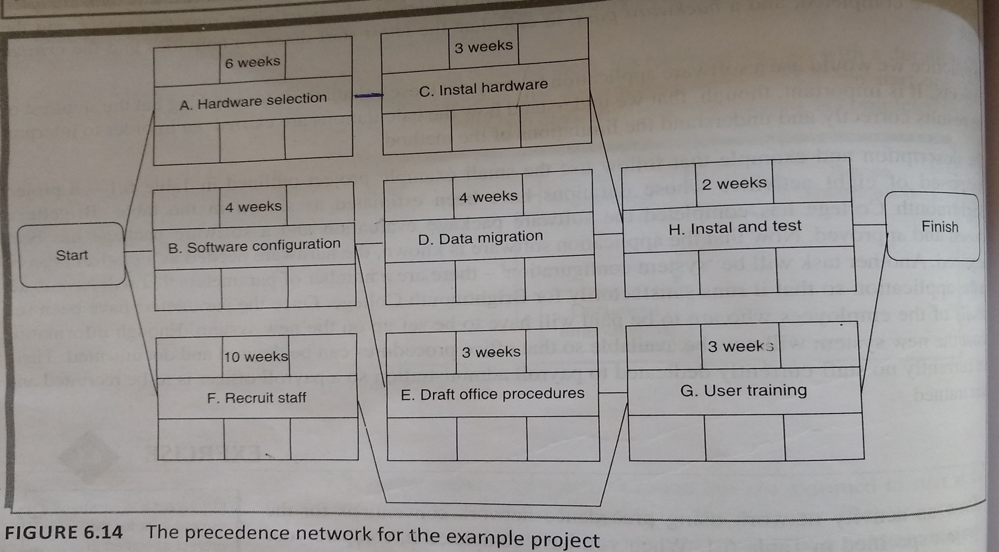
Adding time dimension

Slide 49
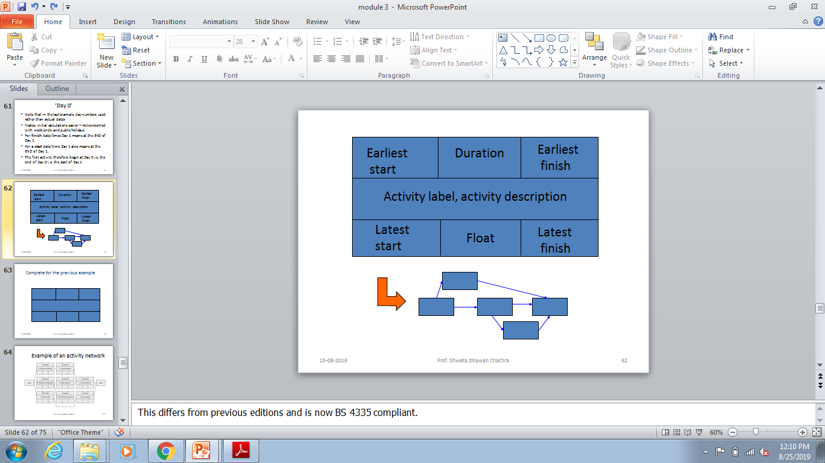
Forward Pass
To calculate the earliest dates at which each activity may be started and completed.

Slide 50
Start and finish times
Latest
finish
Earliest start
activity
Latest start
Earliest finish
Activity ‘write report software’
Earliest start (ES)
Earliest finish (EF) = ES + duration
Latest finish (LF) = latest task can be completed without affecting project end Latest start = LF - duration
Notes:
The time that an activity can start depends on its relationship with the other tasks in the project. The earliest start is when the earliest of the preceding activities upon which the current activity depends will be completed, so that the current one can start. If it starts at this time the earliest the current activity can finish is the earliest start plus its duration.
However, it may be that the activity, although it can start, can be delayed because later activities do not have to start right way. This gives us a latest finish date. The latest start date is the latest finish date less the duration of the activity.
When a student is given coursework to do they do not necessarily start it straight away. They might note when it has got to be handed in, work out that it will only take about three days to do - with a bit of luck - and wait until three days before the hand-in before they start.

Slide 51
Forward Pass
When actual date is known, the calculation is carried out using actual dates
Else day/week nos can be used
By convention, dates indicate the end of a period and the project is thus shown as starting at the end of week 0 .

Slide 52
‘Day 0’
Note that in the last example, day numbers used rather than actual dates
Makes initial calculations easier – not concerned with week-ends and public holidays
For finish date/times Day 1 means at the END of Day 1.
For a start date/time Day 1 also means at the END of Day 1.
The first activity therefore begin at Day 0 i.e. the end of Day 0 i.e. the start of Day 1
Notes:
This also means activity A could finish on Day 5, for example, and a dependent activity B could then start on Day 5 as well (not Day 6).
All this may make more sense if you think about an activities that finish and start halfway through a particular day.
Although we talk about ‘Days’ other time units could be equally valid e.g. Hours, weeks, months. In case of weeks point out that we usually assume 5 day working weeks in our calculations – unless otherwise specified.

Slide 53
Forward pass
Start at beginning (Day 0) and work forward following chains.
Earliest Dates are recorded as they are calculated.
Earliest start date for the current activity = earliest finish date for the previous
When there is more than one previous activity, take the latest of the earliest finish dates for those activities.
EF = day 7
ES = day10
EF = day10

Slide 54
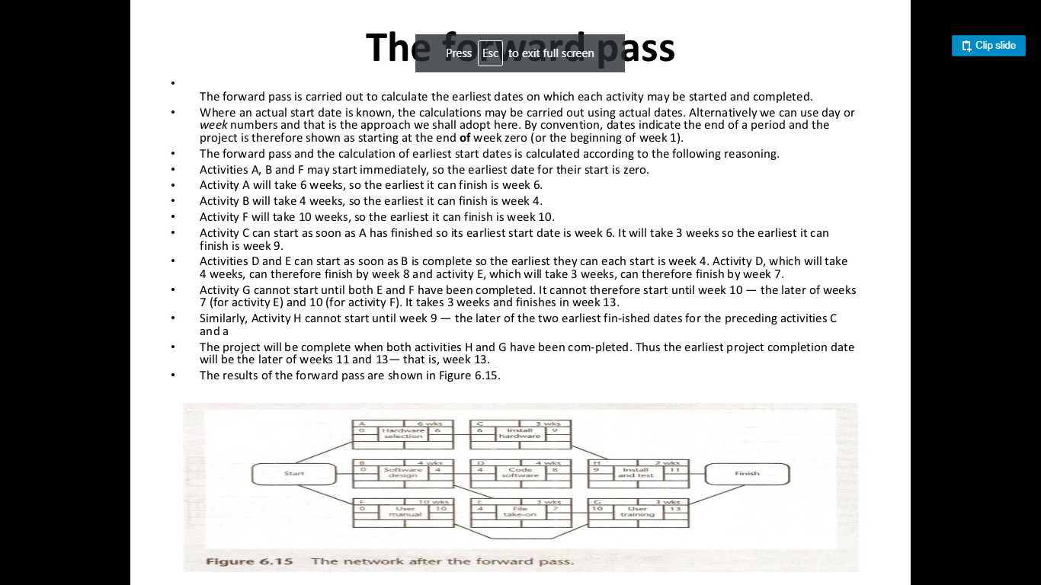
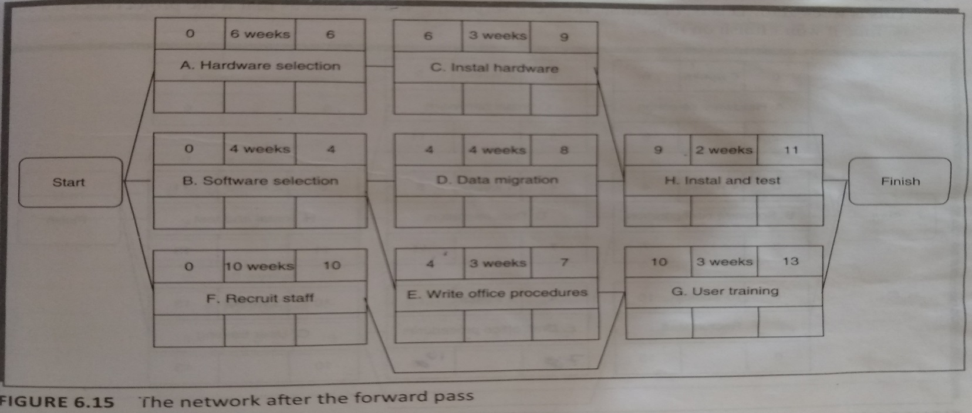
Forward Pass

Slide 55
Forward Pass

Slide 56
Backward Pass
To calculate the latest date at which each activity may be started and finished without delaying the end date of the project.

Slide 57
Backward Pass
The Latest finish date for an activity=latest start date for the activity that commences immediately after that activity is complete.

Slide 58
Backward pass
Start from the last activity
Latest finish (LF) for last activity = earliest finish (EF) of the project
work backwards

Slide 59
Backward Pass
Where more than one activity can commence after the given activity, we take the earliest of the latest start dates for those activities.

Slide 60
Backward pass
Latest finish for current activity = Latest start for the following activity
More than one following activity - take the earliest LS
Latest start (LS) = LF for activity - duration

Slide 61
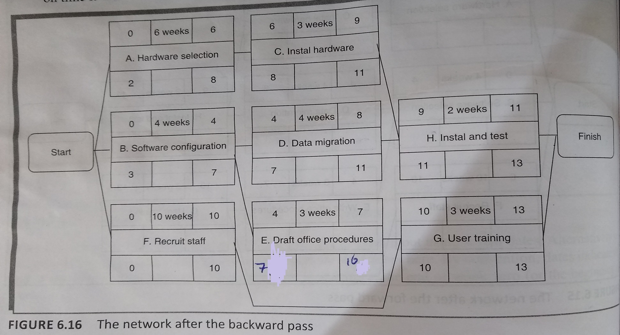
Backward Pass

Slide 62
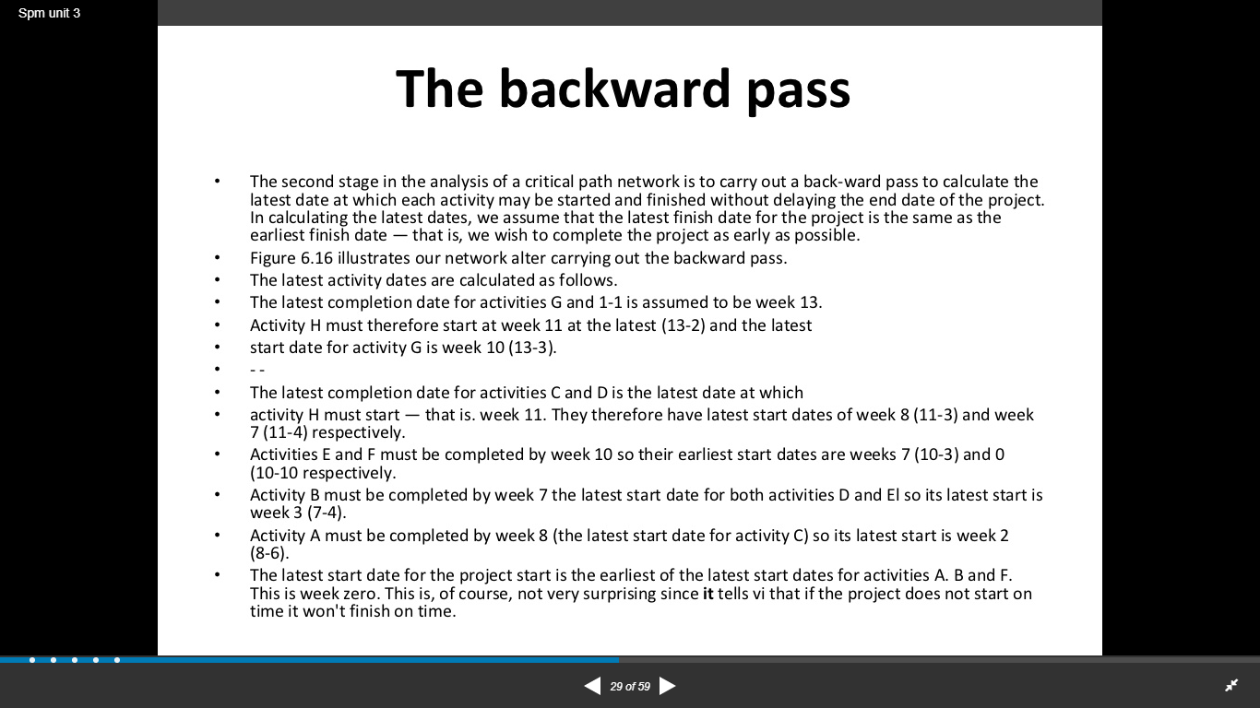
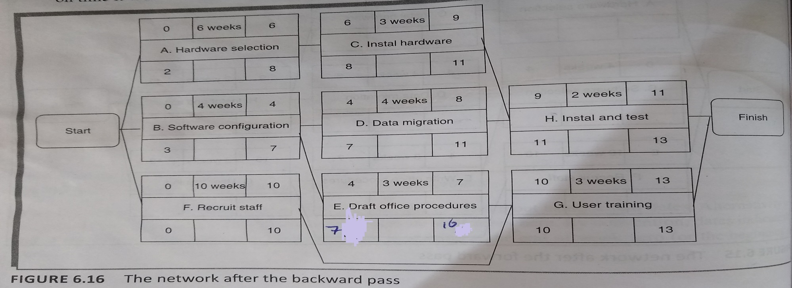
Backward Pass

Slide 63
Backward Pass

Slide 64
Backward Pass

Slide 65
Critical path
Critical path: any delay in an activity on this path will delay whole project
Float=Earliest Start Date-Latest Start Date
=Earliest Finish Date-Latest Finish Date
Also called Total float=float for each activity ;
to distinguish it from other forms of float
Notes:
Yes, there could be more than one critical path if the two longest paths through the network were of equal length.
Where the target completion date for the project was imposed rather than calculated from the earliest finish dates, it might be later that the earliest finish date. In this case there would be no chains of activities with zero floats
The durations of activities are only estimates to start with. As the project proceeds, the estimates will be replaced by actual durations which could be different. This could change the sequence of activities identified as the critical path. Sub-critical paths are chains of activities, not on the planned critical path, but which have small floats and which could easily become the critical path as the project develops.

Slide 66
Total Float is also called Total Slack.
Or Slack
Or float

Slide 67
Critical path
Measure of how much the start or completion of an activity may be delayed without affecting the end date of the project.
Any activity with float=0
is critical as delay in it, will delay the project as a whole.
Notes:
Yes, there could be more than one critical path if the two longest paths through the network were of equal length.
Where the target completion date for the project was imposed rather than calculated from the earliest finish dates, it might be later that the earliest finish date. In this case there would be no chains of activities with zero floats
The durations of activities are only estimates to start with. As the project proceeds, the estimates will be replaced by actual durations which could be different. This could change the sequence of activities identified as the critical path. Sub-critical paths are chains of activities, not on the planned critical path, but which have small floats and which could easily become the critical path as the project develops.

Slide 68
Identifying the Critical Path
Any activity with a float of zero is critical in the sense that any delay in carrying out the activity will delay the completion date of the project as a whole.
There will always be at least one path through the network joining those critical activities –
this path is known as the critical path and is shown bold in Figure 6.17.
The critical path is the path joining all nodes with a zero slack

Slide 69
Critical path
Can there be more than one critical path?
Can there be no critical path?
Sub-critical paths
Notes:
Yes, there could be more than one critical path if the two longest paths through the network were of equal length.
Where the target completion date for the project was imposed rather than calculated from the earliest finish dates, it might be later that the earliest finish date. In this case there would be no chains of activities with zero floats
The durations of activities are only estimates to start with. As the project proceeds, the estimates will be replaced by actual durations which could be different. This could change the sequence of activities identified as the critical path. Sub-critical paths are chains of activities, not on the planned critical path, but which have small floats and which could easily become the critical path as the project develops.

Slide 70
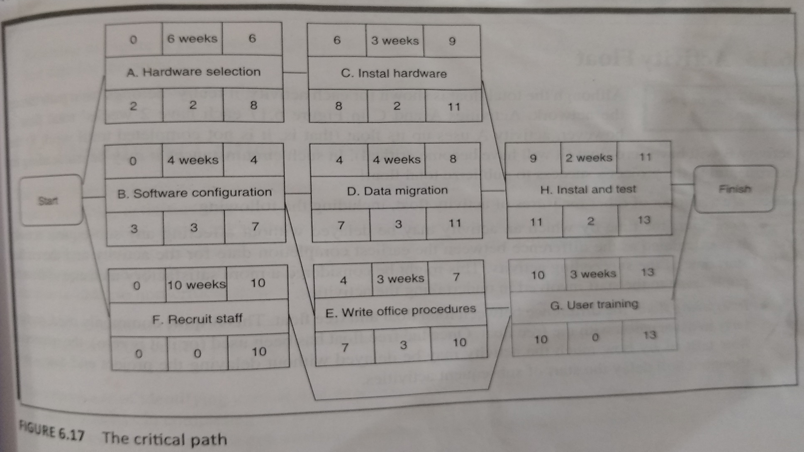
Critical path
There will always be atleast one critical path.
Notes:
Yes, there could be more than one critical path if the two longest paths through the network were of equal length.
Where the target completion date for the project was imposed rather than calculated from the earliest finish dates, it might be later that the earliest finish date. In this case there would be no chains of activities with zero floats
The durations of activities are only estimates to start with. As the project proceeds, the estimates will be replaced by actual durations which could be different. This could change the sequence of activities identified as the critical path. Sub-critical paths are chains of activities, not on the planned critical path, but which have small floats and which could easily become the critical path as the project develops.

Slide 71
Critical path
Critical path is the longest path through the network.
Notes:
Yes, there could be more than one critical path if the two longest paths through the network were of equal length.
Where the target completion date for the project was imposed rather than calculated from the earliest finish dates, it might be later that the earliest finish date. In this case there would be no chains of activities with zero floats
The durations of activities are only estimates to start with. As the project proceeds, the estimates will be replaced by actual durations which could be different. This could change the sequence of activities identified as the critical path. Sub-critical paths are chains of activities, not on the planned critical path, but which have small floats and which could easily become the critical path as the project develops.

Slide 72
Critical path
Significance of CP:
Pay attention to monitoring activities on the CP so that reports of error or resource unavailability are detected and corrected at the earliest
CP must be shortened, to reduce overall duration of project.
Notes:
Yes, there could be more than one critical path if the two longest paths through the network were of equal length.
Where the target completion date for the project was imposed rather than calculated from the earliest finish dates, it might be later that the earliest finish date. In this case there would be no chains of activities with zero floats
The durations of activities are only estimates to start with. As the project proceeds, the estimates will be replaced by actual durations which could be different. This could change the sequence of activities identified as the critical path. Sub-critical paths are chains of activities, not on the planned critical path, but which have small floats and which could easily become the critical path as the project develops.

Slide 73
Perform the Forward Pass, Backward Pass and Identify the Critical Path for the table given below. Calculate the earliest completion date for the project
Exercise 1
Activity | Duration Days | Precedents
A | 5 | -
B | 15 | A
C | 5 | A
D | 8 | A
E | 2 | D
F | 8 | B,C,E

Slide 74
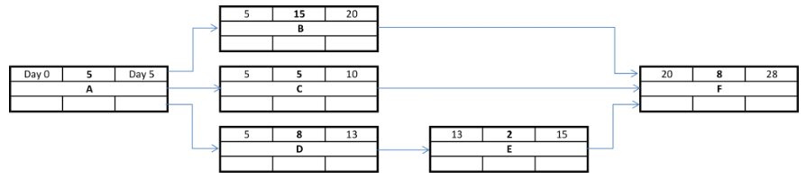
Forward Pass
Exercise 1

Slide 75
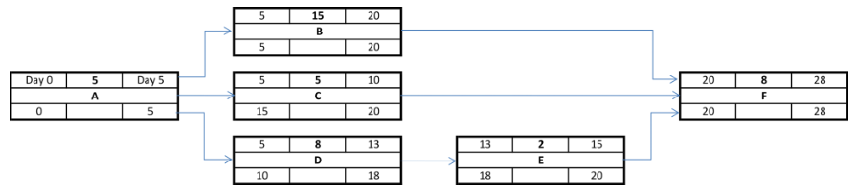
Backward Pass
Exercise 1

Slide 76
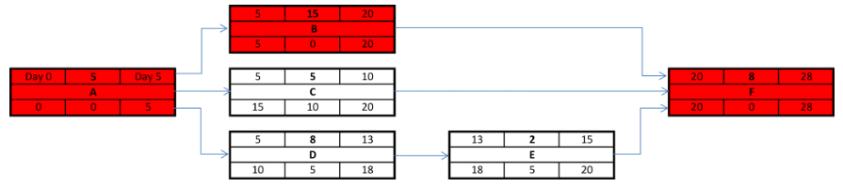
Critical Path
Exercise 1

Slide 77
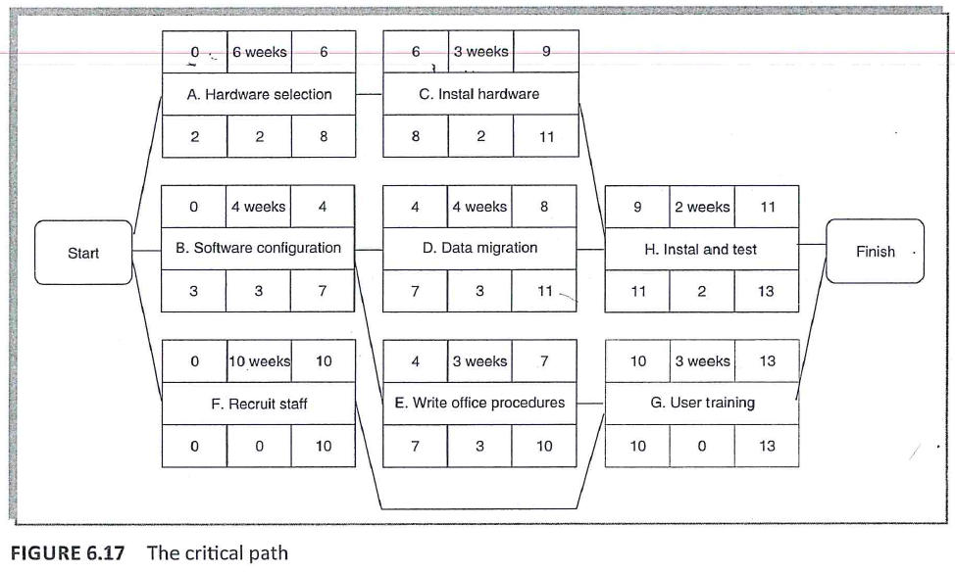
Example Revisited
The activity span-
This is the difference between the earliest start date and the latest finish date and
is a measure of the maximum time allowable for the activity.

Slide 78
Problem with Total float
Activities A and C each have 2 weeks total float.
If activity A uses up its float i.e. it is not completed until week 8 then
Activity B will have Zero float i.e. becomes critical

Slide 79
Problem with Total float
Thus, Total float may be misleading and detrimental to the project’s success to publicize total float.
Total float may be used only once.

Slide 80
Activity Float
There are no of measures of activity float:
Free float/Free Slack
Interfering float

Slide 81
Activity Float
There are no of measures of activity float:
Free float/Free Slack: difference between Earliest Finish Date for the activity and Earliest start date of the succeeding activity
Free float=ES(earliest successor)-EF(activity)

Slide 82
Activity Float
There are no of measures of activity float:
Interfering float: the difference between Total float and Free Float.

Slide 83
Difference between Total Float/Slack and Free Float/Slack
Total slack is the spare time on an activity that, if used up and the activity is delayed any further, delays successors and affects the end date of the project as a whole.
Free slack is the spare time on an activity that, if used up, does not affect the early start time of any succeeding activities (i.e., will not affect the total slack or delay any successor).

Slide 84
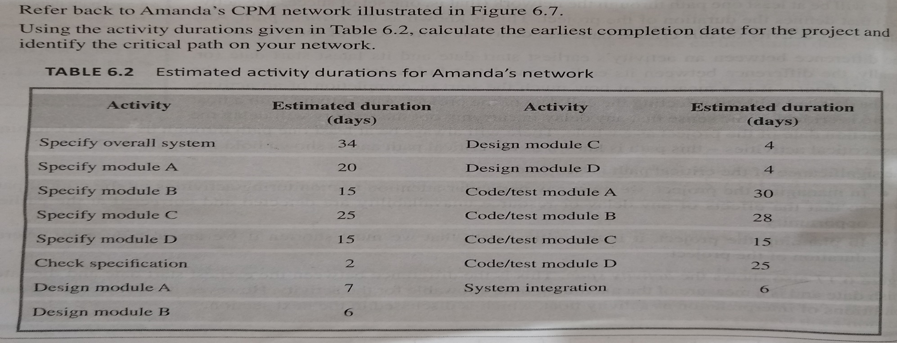
Exercise 2
Draw the AON Diagram for the following example, Perform the Forward Pass, Backward Pass. Further Calculate the Total Float, Free Float for all the activities.

Slide 85
Exercise 3
Calculate the Free float and Interfering float
For each of the activities shown in Amanda’s activity network.

Slide 86
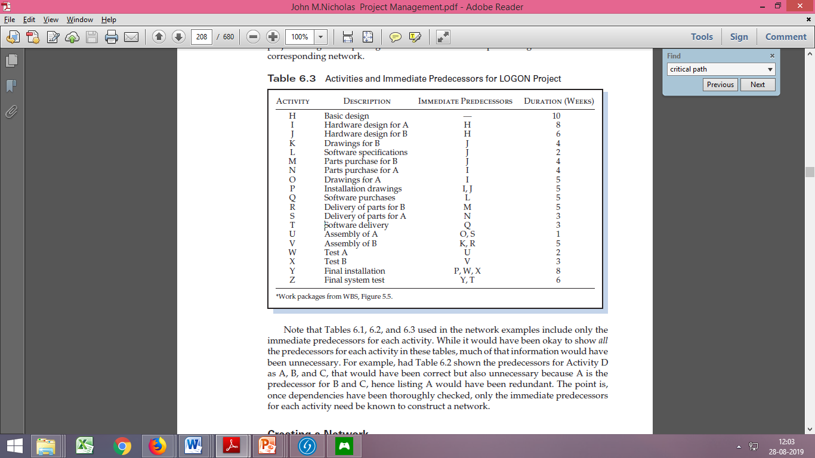
Draw the AON Diagram for the following example, Perform the Forward Pass, Backward Pass. Further Calculate the Total Float, Free Float for all the activities.
Exercise 4

Slide 87
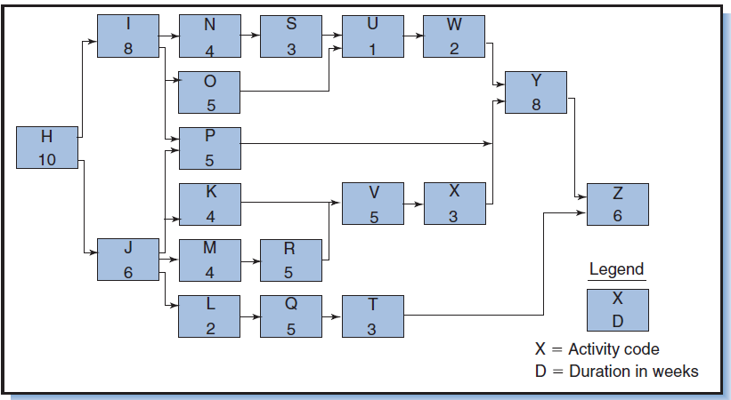
Exercise 4

Slide 88
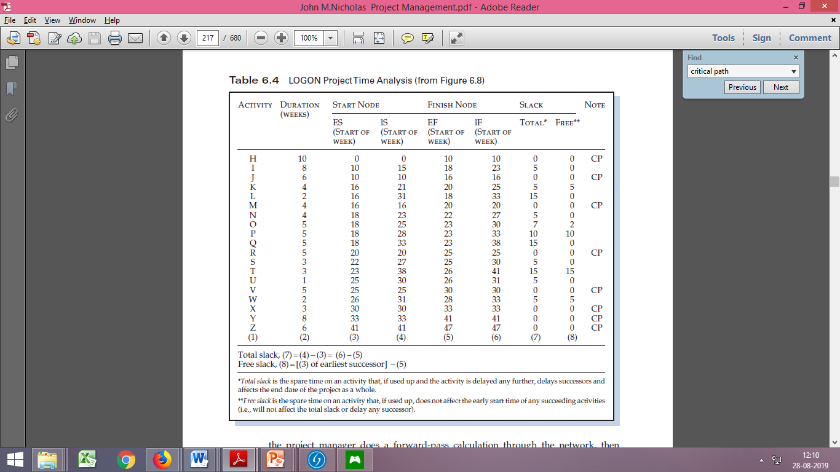
Exercise 4

Slide 89
AOA Networks
CPM and PERT methods used AOA Networks
Less popular
Still used
Introduced the concept of events
Activities=Links
Nodes=events of activities starting or finishing

Slide 90
Draw AOA Network for the following table

Slide 91
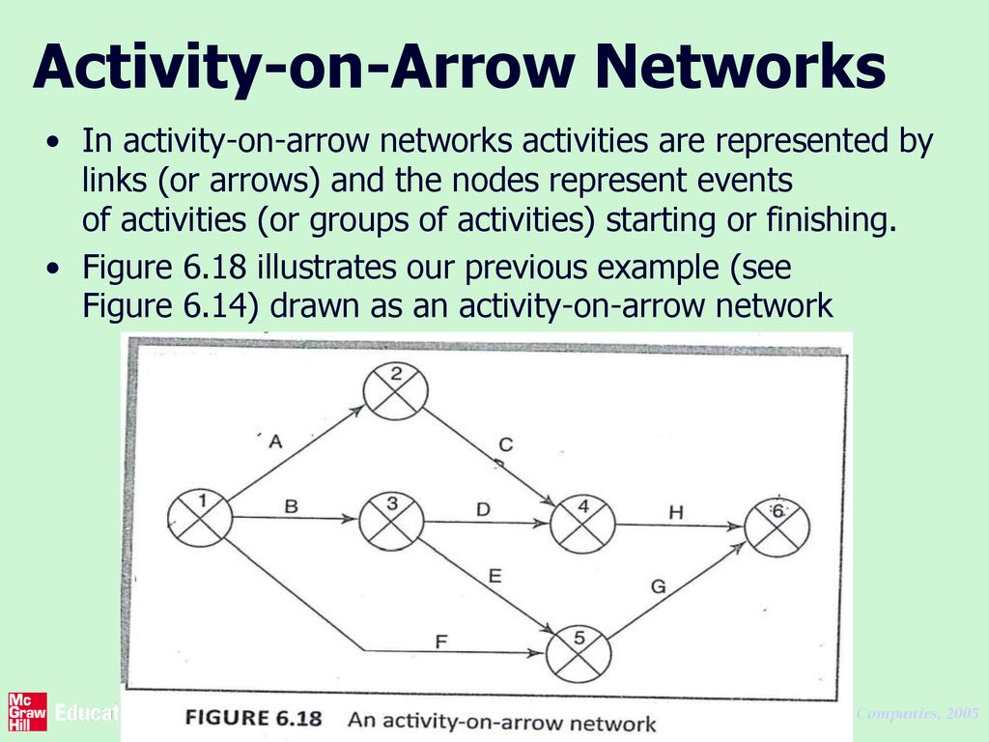
AOA Networks

Slide 92
Rules and Conventions AOA Network
A project network may have only one start node.- Requirement of AOA rather than merely desirable as in AON
A project network may have only one end node.-
Again a Requirement.
3. A link has duration:
link represents activity and, in general, activities take time to execute.

Slide 93
Rules and Conventions AOA Network
Nodes have no duration: Nodes are events and, as such, are instantaneous points in time.
The source node is the event of the project becoming ready to start
The sink node is the event of the project becoming completed.
Intermediate nodes represent two simultaneous events –
the event of all activities leading into a node having been completed and
the event of all activities leading out of that node being in a position to be started.
5. Time moves from left to right.

Slide 94
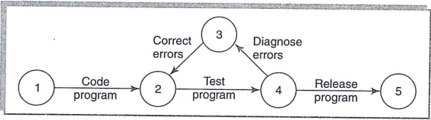
Rules and Conventions AOA Network
Nodes are numbered sequentially: There are no precise rules about node numbering but nodes should be numbered so that head nodes (those at the 'arrow' end of an activity) always have a higher number than tail.
‘A network may not contain loops. –either error of logic or situation that must be resolved by itemizing iterations of activity groups.

Slide 95
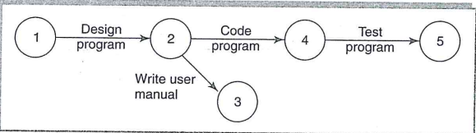
Rules and Conventions AOA Network
8. A network may not contain dangles.-
Dangling activity cannot exist as it would suggest 2 completion points for the project.
All events except First and Last, must have atleast one activity entering them and atleast one activity leaving them.

Slide 96
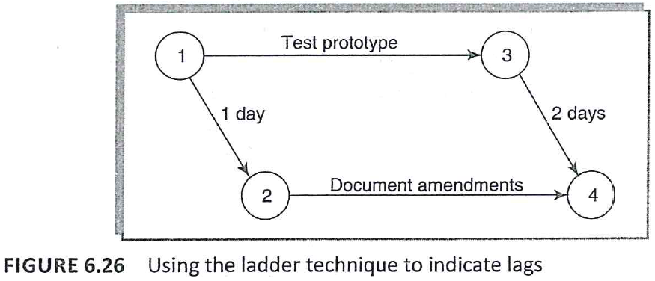
Representing lagged activities
AOA are less elegant when it comes to representing lagged parallel activities.
We need to represent these with pairs of dummy activities as shown in Figure.
Where parallel activities have a time lag , show this as “ladder” of activities.

Slide 97
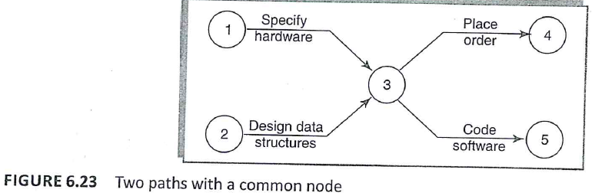
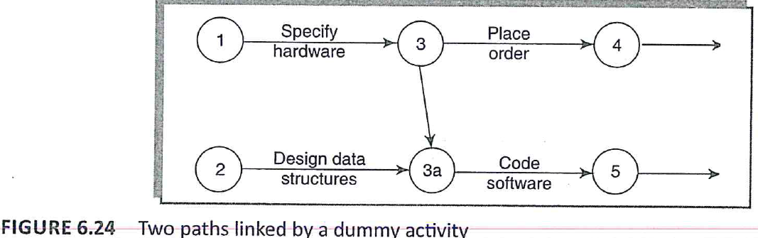
Using dummy activities
When two paths within a network have a common event although they are, in other respects, independent, a logical error such as that illustrated in Figure 6.23 might occur
We can resolve this problem by separating the two (more or less) independent paths and introducing a dummy activity

Slide 98
Using dummy activities
A dummy activity is used to illustrate precedence relationships in AOA networks.
It serves only as a “connector”
It is not a “real” activity, and represents neither work nor time.

Slide 99
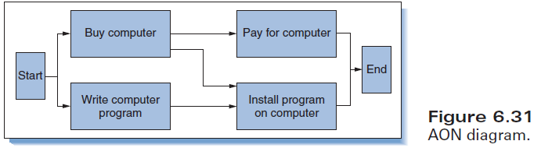
Using dummy activities
An engineer decides to write a new computer program and to buy a new computer to run it on. The activities and their dependencies are illustrated in the AON network in Figure.
The dependencies (excluding ones from start and to end nodes) are:
1. Pay for the computer after buying the computer
2. Install the computer program after writing the program and after buying the computer.

Slide 100
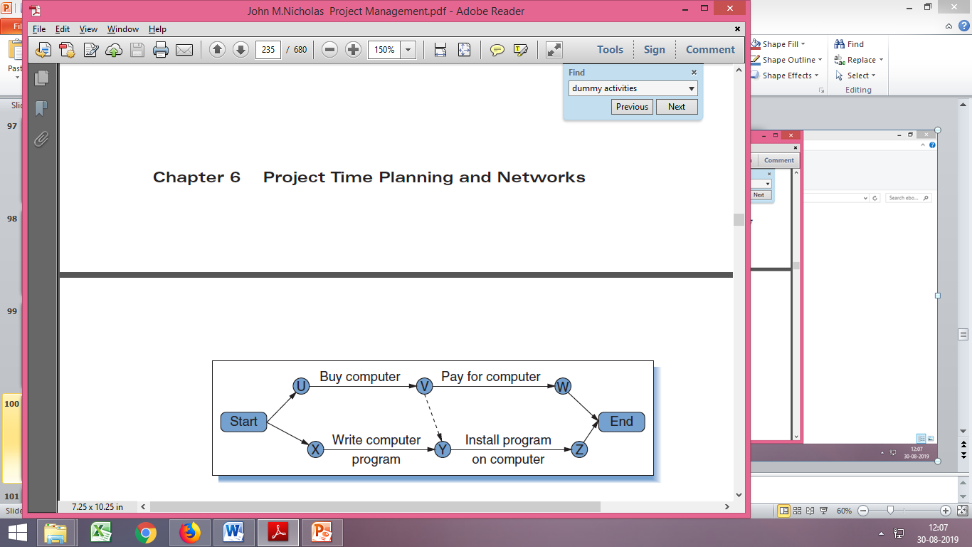
Using dummy activities
The AOA network for this project is shown in Figure.
To show the dependencies “install program” after “buy computer” and “write program” requires a dummy activity (the dashed arrow) between node V and node Y.
This dummy links “install program” to its two immediate predecessors, “buy computer” and “write computer program.”
Notice that the overall network has only one “Start” node and one “End” node.

Slide 101
Using dummy activities
Dummy activities, shown as dotted lines on the network diagram,
Have a zero duration
Use no resources.
These are problems that do not occur with activity-on-node networks.

Slide 102
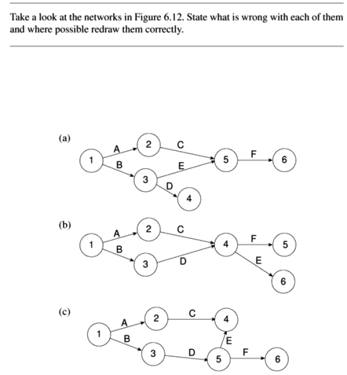

Slide 103
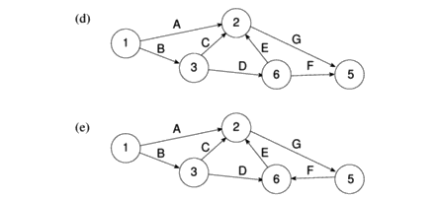

Slide 104
Single end node
Dummy activities +
Single end node
Single end node

Slide 105
Loop=GFE

Slide 106
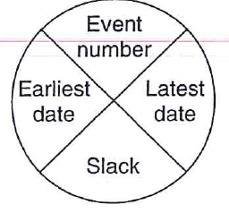
Activity labelling
No of different conventions
One of the more common conventions for labelling nodes is the following:
The diagram is used to record information about the events rather than the activities

Slide 107
Activity labelling
Divide the node circle into quadrants.
The latest and earliest dates by which the event should occur, and the event slack (which will be explained later).

Slide 108
The forward pass (activity-on-arrow network.)
The forward pass is carried out to calculate :
the earliest date on which each event may be achieved and
the earliest dates on which each activity may be started and completed.
The earliest date for an event is the earliest date by which all activities upon which it depends can be completed.

Slide 109
The forward pass (activity-on-arrow network.)
Using Figure 6.18 and Table 6.1 the calculation proceeds according to the following reasoning:

Slide 110
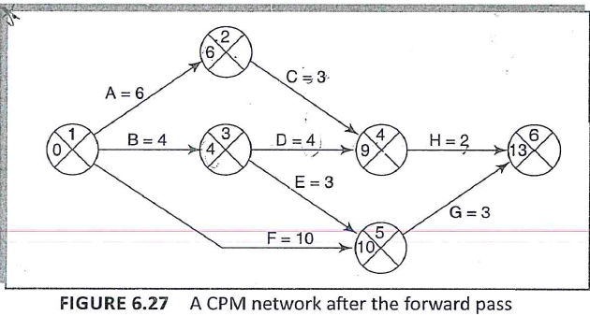
Activities A, Band F may start immediately, so the earliest date for event 1 is zero and the earliest start date for these three activities is also zero.

Slide 111
Activity A will take 6 weeks, so the earliest it can finish is week 6 (recorded in the activity table). Therefore the earliest we can achieve event 2 is week 6.
Activity B will take 4 weeks, so the earliest it can finish and the earliest we can achieve event 3 is week 4.

Slide 112
Activity F will take 10 weeks, so the earliest it can finish is week 10-
we cannot, however, tell whether or not this is also the earliest date that we can achieve event 5
since we have not yet, calculated when activity E will finish.

Slide 113
Activity E can start as early as week 4 (the earliest date for event 3) and, since it is forecasted to take 3 weeks, will be completed, at the earliest, at the end of week 7.
Event 5 may be achieved when both E and F have been completed, that is, week 10 (the later of 7 and 10).

Slide 114
Similarly, we can reason that event 4 will have an earliest date of week 9. This is the later of the earliest finish for activity D (week 8) and the earliest finish for activity C (week 9).
The earliest date for the completion of the project, event 6, is therefore the end of week '13 - the later of 11 (the earliest finish for H) and 13 (the earliest finish for G).
The results of the forward pass are shown in Figure 6.27 and Table 6.3.

Slide 115
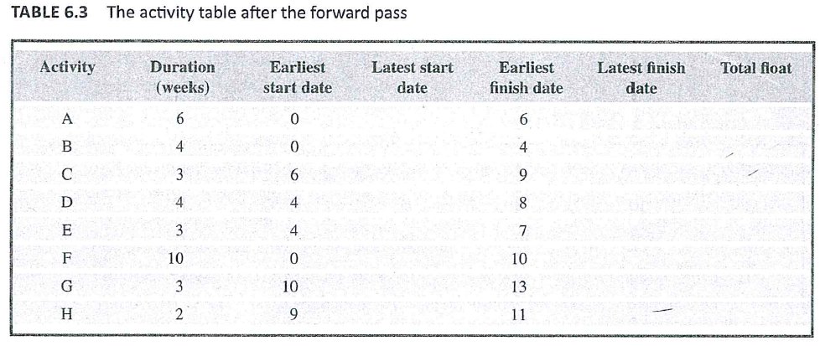
Forward Pass
Earliest Date+ Duration

Slide 116
The backward pass (activity-on-arrow network.)
The second stage is to carry out a backward pass:
to calculate the latest date at which each event may be achieved, and
each activity started and finished, without delaying the end date of the project.
The latest date for an event is the latest date by which all immediately following activities must be started for the project to be completed on time.

Slide 117
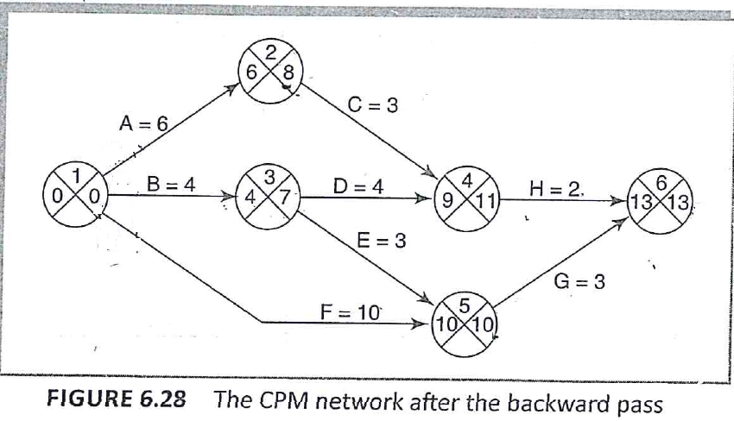
The backward pass (activity-on-arrow network.)
We assume that the latest finish date for the project is the same as the earliest finish date –
that is, we wish to complete the project as early as possible.

Slide 118
The backward pass (activity-on-arrow network.)
Figure 6.28 illustrates our network and Table 6.4 the activity table after carrying out the backward pass - as with the forward pass.

Slide 119
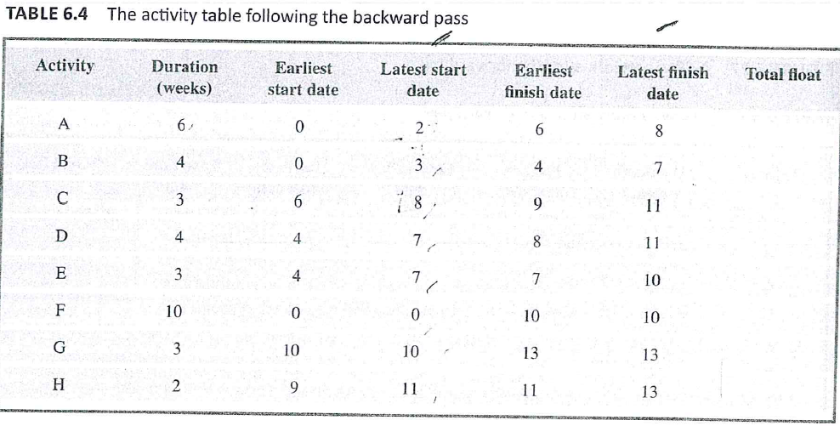
Event dates are recorded on the diagram and activity dates on the activity table .
Latest Date - Duration

Slide 120
Identifying the critical path
The critical path is the longest path through the network
Slack is the difference between the earliest date and the latest date for an event.
it is a measure of how late an event may be without affecting the end date of the project.

Slide 121
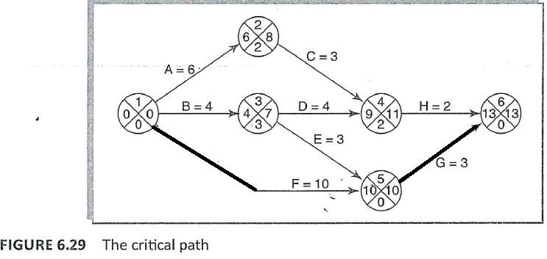
Identifying the critical path
The critical path is the longest path through the network
Slack is the difference between the earliest date and the latest date for an event.
it is a measure of how late an event may be without affecting the end date of the project.
The critical path is the path joining all nodes with a zero slack (Figure 6.29).

